Slide 1
Co-Kriging Method Performance in Estimating Number of COVID-19 Positive Confirmed Cases in East Java Province
Presenter : Siti Amelia Dewi Safitri
Corresponding Author : Nur Chamidah
Department of Mathematics, Airlangga University, Surabaya, Indonesia
Co Authors : Fajrina Aisyah Putri,, Belindha Ayu Ardhani

Slide 2
Introduction

Slide 3
Background of Research
World Health Organization (WHO) declare COVID-19 as global pandemic on March 12th, 2020.
COVID-19 in Indonesia was first confirmed on March 2nd, 2020.
The confirmed cases also jumped sharply and currently has infected many provinces in Indonesia, including East Java Province.
The number of positive confirmed cases increased to higher level at the end of June and the beginning of July 2020, and then it led East Java to become the province with the highest number of confirmed cases in Indonesia during the period.
it is necessary to estimate the number of confirmed cases in several cities, such as Sidoarjo, Gresik, Pasuruan, Lamongan, Tuban, Malang, Sampang, Sumenep, and Mojokerto using co-kriging method.
This study specifically contributed in the performance analysis of co-kriging in the estimation of the number of COVID-19 cases.

Slide 4
Literature Review

Slide 5
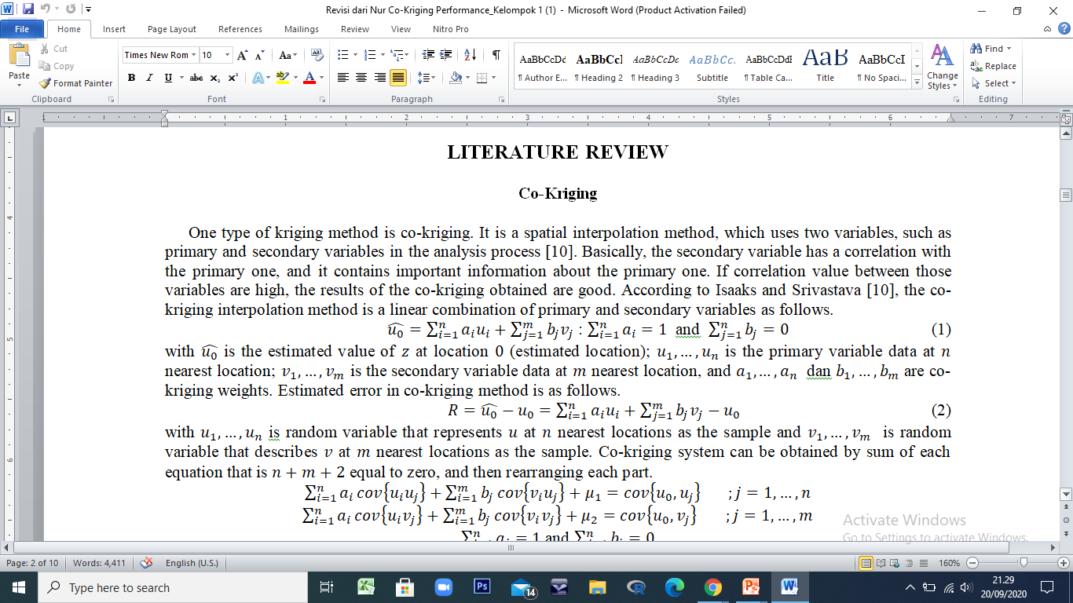

Introduction of Co-Kriging
One type of kriging method is co-kriging. It is a spatial interpolation method, which uses two variables in the analysis process. Basically, the secondary variable has a correlation with the primary one, and it contains important information about the primary one. If correlation value between those variables are high, the results of the co-kriging obtained are good.
Co-kriging interpolation method is a linear combination of primary and secondary variables as follows.
Estimated error in co-kriging method is as follows.

Slide 6
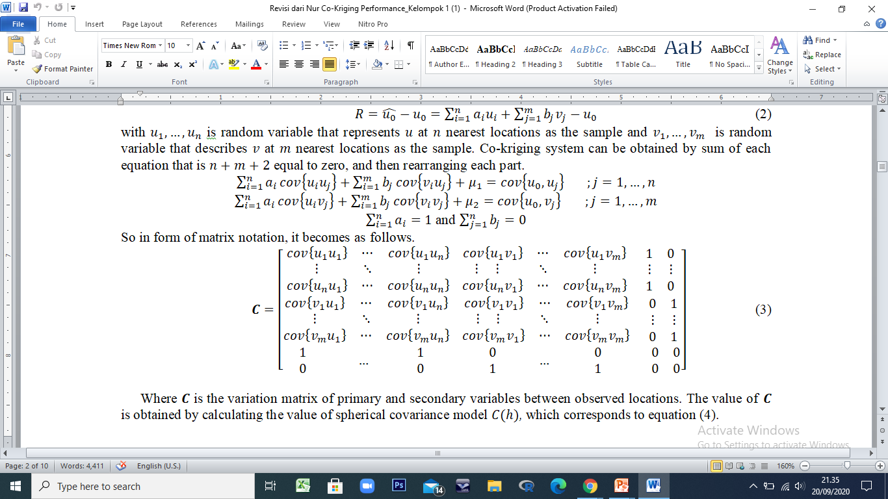
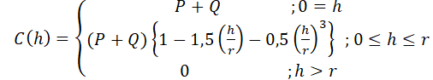
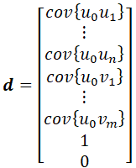
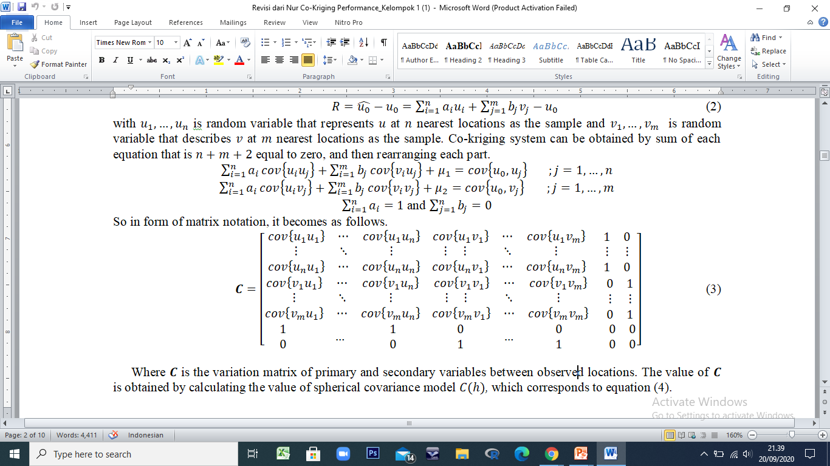
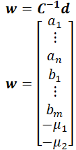
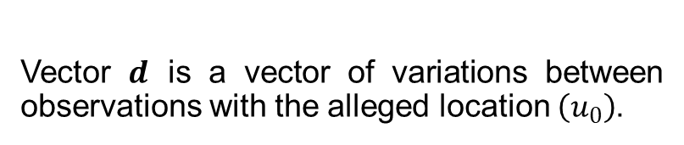
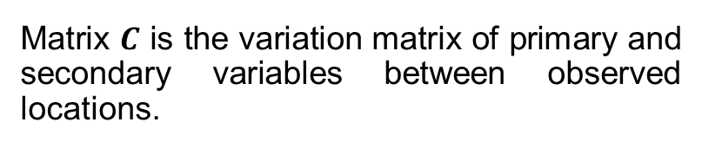
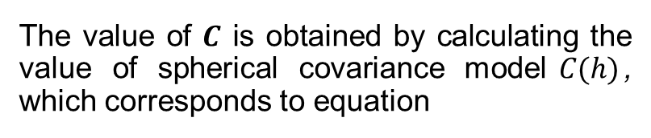
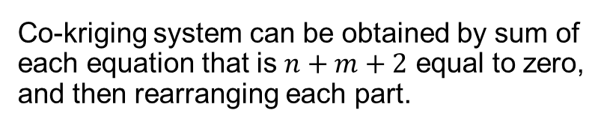
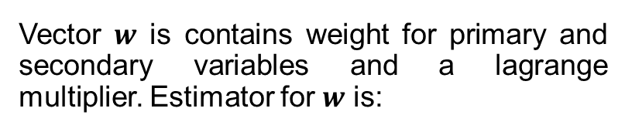
Co-Kriging System
Co-kriging system can be obtained by sum of each equation that is $n+m+2$ equal to zero, and then rearranging each part.
The value of $C$ is obtained by calculating the value of spherical covariance model$C(h)$, which corresponds to equation
Vector $d$ is a vector of variations between observations with the alleged location $\left(u_{0}\right)$.
Matrix $C$ is the variation matrix of primary and secondary variables between observed locations.
Vector $w$ is contains weight for primary and secondary variables and a lagrange multiplier. Estimator for $w$ is:

Slide 7
Data and Procedures

Slide 8
Research Variables
No | Variables | Definition
1 | Primary variable | The number of COVID-19 confirmed cases from nine nearest areas to the estimated area
2 | Secondary variable | The number of suspect cases from five nearest areas to the estimated area
3 | Distance variable | The longitude and latitude coordinates of each city in East Java Province
The estimated sample were Sidoarjo, Gresik, Pasuruan, Lamongan, Tuban, Malang, Sampang, Sumenep, and Mojokerto.
The data were obtained from the website www.infocovid19.jatimprov.go.id, which is handled by East Java Government on July 21st.

Slide 9
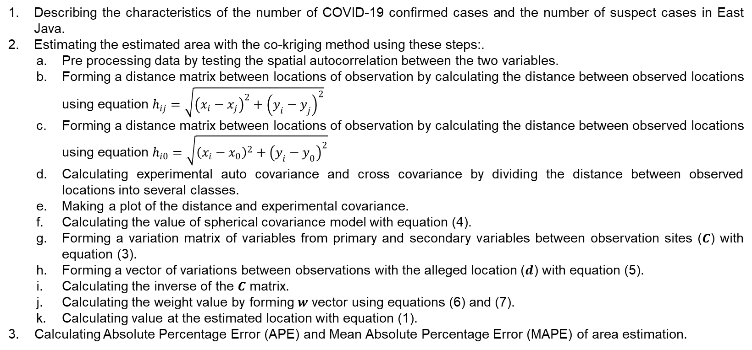
Steps of Analysis
Describing the characteristics of the number of COVID-19 confirmed cases and the number of suspect cases in East Java.
Estimating the estimated area with the co-kriging method using these steps:.
Pre processing data by testing the spatial autocorrelation between the two variables.
Forming a distance matrix between locations of observation by calculating the distance between observed locations using equation $h_{ij}=\sqrt{{\left(x_{i}−x_{j}\right)}^{2}+{\left(y_{i}−y_{j}\right)}^{2}}$
Forming a distance matrix between locations of observation by calculating the distance between observed locations using equation $h_{i0}=\sqrt{{\left(x_{i}−x_{0}\right)}^{2}+{\left(y_{i}−y_{0}\right)}^{2}}$
Calculating experimental auto covariance and cross covariance by dividing the distance between observed locations into several classes.
Making a plot of the distance and experimental covariance.
Calculating the value of spherical covariance model with equation (4).
Forming a variation matrix of variables from primary and secondary variables between observation sites ($C$) with equation (3).
Forming a vector of variations between observations with the alleged location ($d$) with equation (5).
Calculating the inverse of the $C$ matrix.
Calculating the weight value by forming $w$ vector using equations (6) and (7).
Calculating value at the estimated location with equation (1).
3. Calculating Absolute Percentage Error (APE) and Mean Absolute Percentage Error (MAPE) of area estimation.

Slide 10
Descriptive Statistics

Slide 11
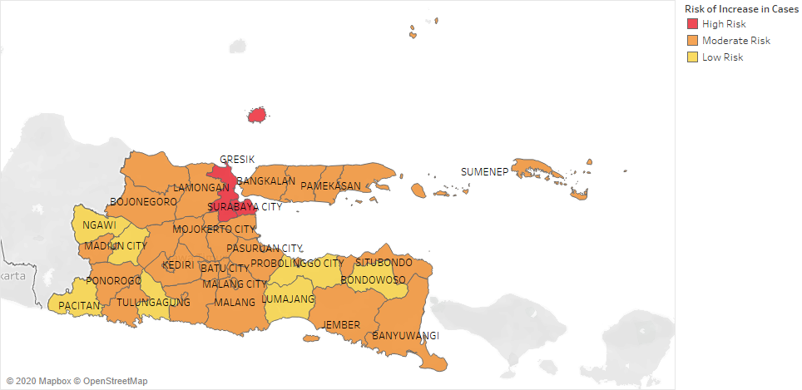
Descriptive Statistics
Map Of The Distribution Of The COVID-19 Case In East Java
The city that has highest number of confirmed cases is Surabaya, then followed by Sidoarjo, and Gresik. Each of them has more than 1,000 cases as of July 21st, 2020. Then, the classification of region in East Java related to the risk of increase in cases produces three clusters, such as regions with high risk, regions with moderate risk, and regions with low risk.

Slide 12
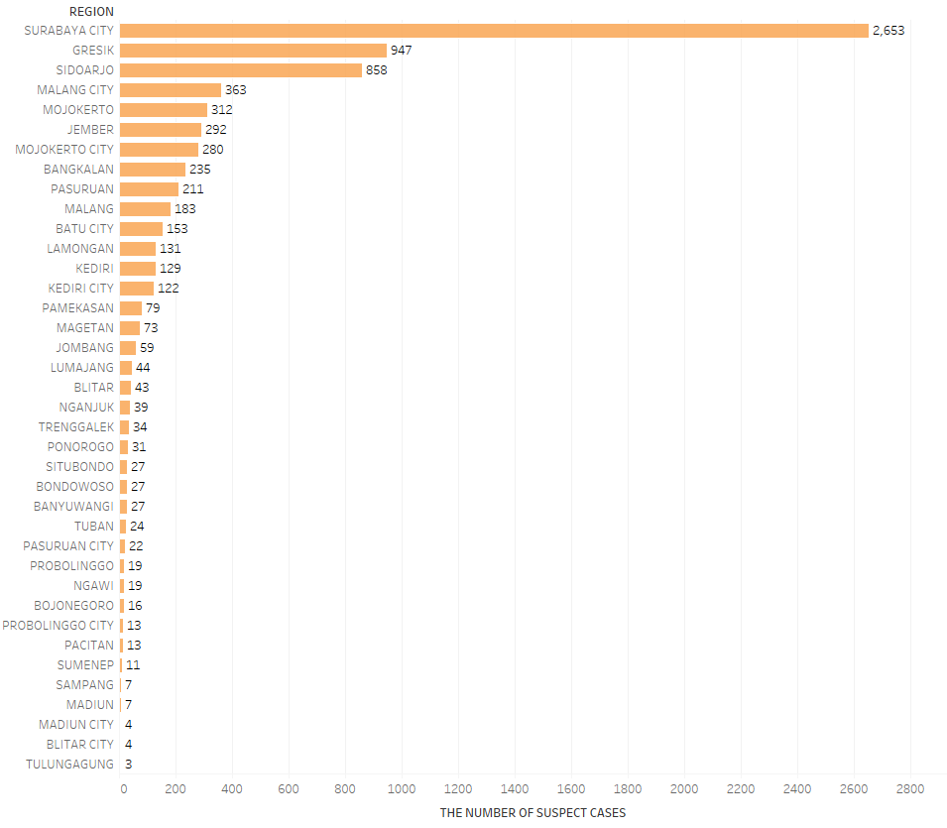
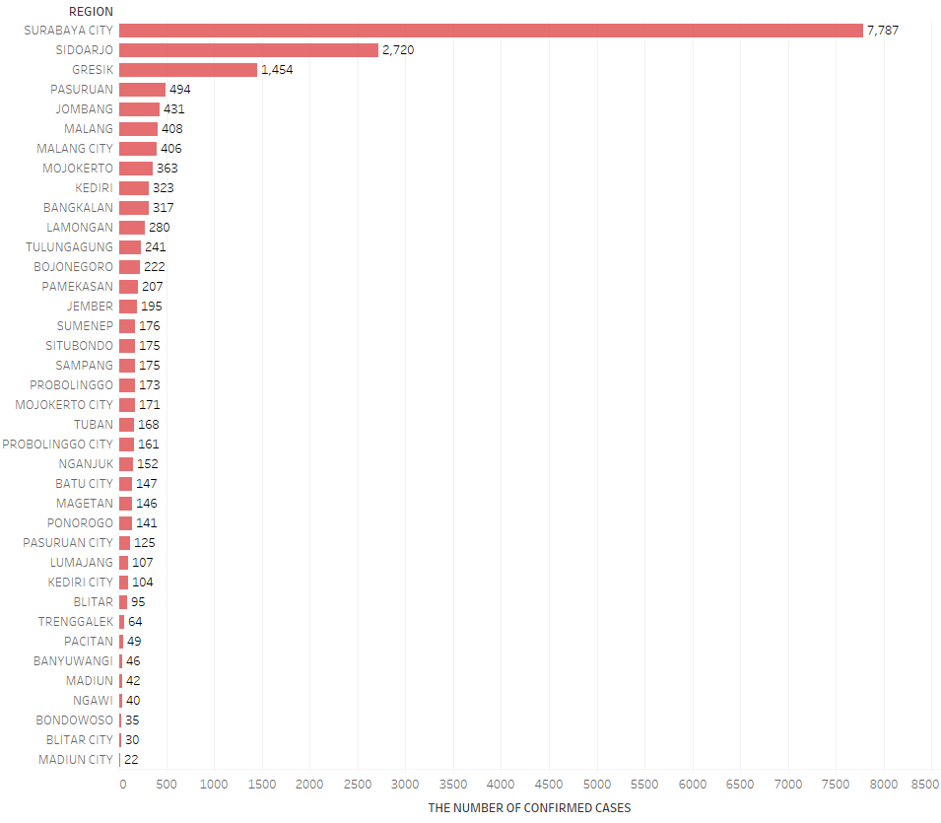
Descriptive Statistics
Number of Suspect Cases and Confirmed Cases in Each City in East Java

Slide 13
Preprocessing

Slide 14
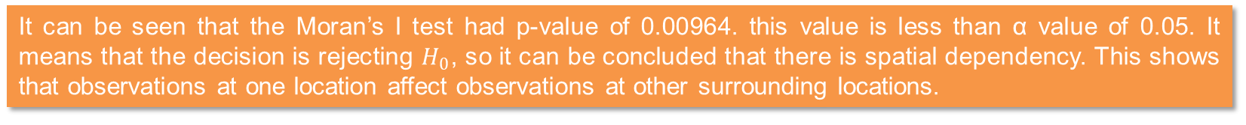

Spatial Autocorrelation
It aims to see whether observations at one location affect observations at other surrounding locations. It can be done by Moran's I test using the following hypothesis testing below.
$H_{0}:$ There is no spatial dependency
$H_{1}:$ There is spatial dependency
DIAGNOSTICS FOR SPATIAL DEPENDENCE
FOR WEIGHT MATRIX : Weight_Uniform
(row-standardized weights)
TEST MI/DF VALUE PROB
Moran's I (error) 0.1973 2.5885 0.00964
Lagrange Multiplier (lag) 1 2.6176 0.10568
Robust LM (lag) 1 0.6315 0.42682
Lagrange Multiplier (error) 1 3.5861 0.05826
Robust LM (error) 1 1.6000 0.20590
Lagrange Multiplier (SARMA) 2 4.2176 0.12138
It can be seen that the Moran’s I test had p-value of 0.00964. this value is less than α value of 0.05. It means that the decision is rejecting $H_{0}$, so it can be concluded that there is spatial dependency. This shows that observations at one location affect observations at other surrounding locations.

Slide 15
Number of COVID-19 Confirmed Cases Estimation in the Estimated Areas

Slide 16
Sidoarjo
The number of confirmed cases used were Gresik, Malang City, Malang, Kediri, Nganjuk, Tulungagung, Situbondo, Magetan, and Lamongan, which were also used as primary variables; and the number of suspect cases used were Mojokerto City, Mojokerto, Lumajang, Jember, Ponorogo, and Pasuruan, which were also used as secondary variables.
Experimental Covariance Value for Each Class in the Estimation of the Number of COVID-19 Confirmed Cases in Sidoarjo
Plot of the Median of each Class with Experimental Covariance Value
Class | Interval |  | Frequency | Median | C(h)
1 | 0 | 0.68 | 26 | 0.34 | 56917.89
2 | 0.681 | 1.36 | 32 | 1.0205 | -21318.9
3 | 1.361 | 2.04 | 17 | 1.7005 | -29248.1
4 | 2.041 | 2.72 | 11 | 2.3805 | -2016.85
5 | 2.721 | 3.4 | 9 | 3.0605 | -21912.5
6 | 3.401 | 4.08 | 6 | 3.7405 | 9996
7 | 4.081 | 4.76 | 3 | 4.4205 | -361.269
8 | 4.761 | 5.44 | 2 | 5.1005 | -800

Slide 17
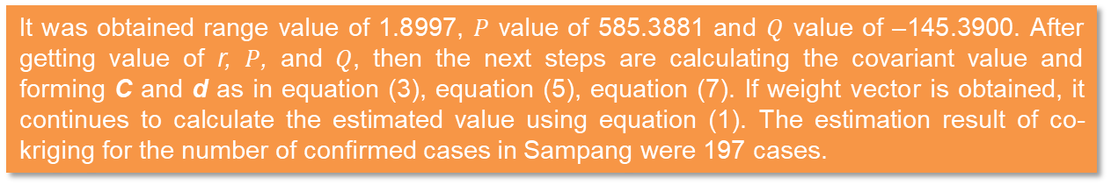
Sampang
The numbers of confirmed cases used were Pamekasan, Lamongan, Lumajang, Bangkalan, Batu City, Sumenep, Situbondo, Jombang and Bondowoso, which were also used as primary variables; and the number of suspect cases used were Tuban, Blitar, Probolinggo, Sampang, Pasuruan City, and Probolinggo City, which were also used as secondary variables.
Experimental Covariance Value for Each Class in the Estimation of the Number of COVID-19 Confirmed Cases in Sampang
Plot of the Median of each Class with Experimental Covariance Value
Class | Interval |  | Frequency | Median | C(h)
1 | 0.000000 | 0.000000 | 73 | 0.000000 | 585.388128
2 | 0.000001 | 0.759894 | 60 | 0.379948 | -790.240104
3 | 0.759895 | 1.519789 | 28 | 1.139842 | -1467.905521
4 | 1.519790 | 2.279683 | 16 | 1.899736 | -145.390000
5 | 2.279684 | 3.039577 | 16 | 2.659630 | 241.195313
6 | 3.039578 | 3.799471 | 20 | 3.419525 | -649.550000
7 | 3.799472 | 4.559366 | 8 | 4.179419 | 120.593750
8 | 4.559367 | 5.319260 | 4 | 4.939313 | -18.062500
It was obtained range value of 1.8997, $P$ value of 585.3881 and $Q$ value of –145.3900. After getting value of r, $P$, and $Q$, then the next steps are calculating the covariant value and forming C and d as in equation (3), equation (5), equation (7). If weight vector is obtained, it continues to calculate the estimated value using equation (1). The estimation result of co-kriging for the number of confirmed cases in Sampang were 197 cases.

Slide 18
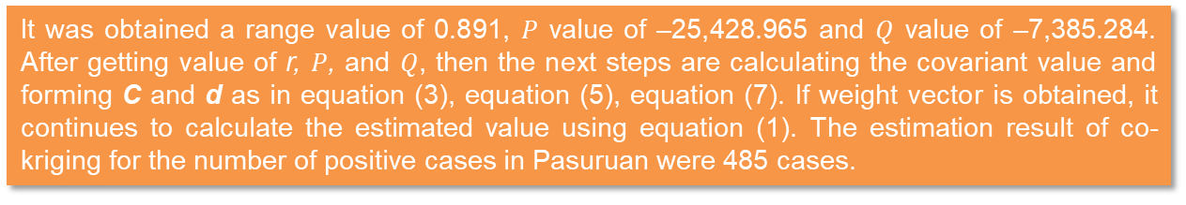
Pasuruan
The numbers of confirmed cases used were Pamekasan, Lamongan, Lumajang, Bangkalan, Batu City, Sampang, Mojokerto, Malang City, and Sidoarjo, which were also used as primary variables; and the number of suspect cases used were Situbondo, Bondowoso, Probolinggo, Sumenep, Pasuruan City, and Probolinggo City, which were also used as secondary variables.
Experimental Covariance Value for Each Class in the Estimation of the Number of COVID-19 Confirmed Cases in Pasuruan
Plot of the Median of each Class with Experimental Covariance Value
Class | Interval |  | Frequency | Median | C(h)
1 | 0.000000 | 0.593923 | 61 | 0.296962 | -25428.96539
2 | 0.593924 | 1.187848 | 78 | 0.890886 | -7385.28442
3 | 1.187849 | 1.781772 | 34 | 1.484810 | 7050.14625
4 | 1.781773 | 2.375697 | 0 | 2.078735 | 0.00000000
5 | 2.375698 | 2.969621 | 0 | 2.672659 | 0.00000000
6 | 2.969622 | 3.563545 | 20 | 3.266584 | -39465.04898
7 | 3.563546 | 4.157470 | 18 | 3.860508 | 759.47556
8 | 4.157471 | 4.751394 | 14 | 4.454432 | -87.70635
It was obtained a range value of 0.891, $P$ value of –25,428.965 and $Q$ value of –7,385.284. After getting value of r, $P$, and $Q$, then the next steps are calculating the covariant value and forming C and d as in equation (3), equation (5), equation (7). If weight vector is obtained, it continues to calculate the estimated value using equation (1). The estimation result of co-kriging for the number of positive cases in Pasuruan were 485 cases.

Slide 19
Estimation in Other Regions
By using the same way of estimation, each of the others had different results. Based on the analysis, it gained:
Gresik had the final estimation result of 1,035 cases
Mojokerto had the value of 483 cases
Lamongan had the value of 221 cases
Tuban had the value of 161 cases
Malang had the value of 333 cases
Sumenep had the value of 158 cases.

Slide 20
The Performance of Co-Kriging Method

Slide 21
The Performance of Co-Kriging Method
Estimation Results, Actual Values, and Error of the Number of Positive Cases in Several Cities of East Java Using the Co-kriging
City | Estimated Value | Actual Value | Absolute Percentage Error (APE) (%)
Sidoarjo | 1,808 | 2,720 | 33.53%
Mojokerto | 483 | 363 | 33.06%
Gresik | 1,035 | 1,454 | 28.82%
Lamongan | 221 | 280 | 21.07%
Malang | 333 | 408 | 18.38%
Sampang | 197 | 175 | 12.57%
Sumenep | 158 | 176 | 10.23%
Tuban | 161 | 168 | 4.17%
Pasuruan | 485 | 494 | 1.82%
The percentage of errors varied between 1.82% and 33.53%. It can be calculated that the MAPE value for estimating the number of positive cases in several in sample areas of East Java was 18.18%. Because the MAPE value is in range of 10% – 20%, the estimated value is getting closer to the actual value. It means that co-kriging produced good estimation for the number of COVID-19 confirmed cases in several cities of East Java.

Slide 22
Conclusion

Slide 23
Conclusion
Co-kriging as part of Geographically Weighted Regression can be applied in many estimation based on spatial information using primary and secondary variables. The analysis shows that this method has good performance for estimating the number of COVID-19 positive cases in East Java Province. It was based on the MAPE value of 18.17%, which is in the range of 10% – 20%. It means that co-kriging has ability to produce good estimation. For further research, the data can be applied based on co-kriging method using comparison of variogram analysis with several models.

Slide 24
Thank you

